Slide 1



Data Science Project
Team 5

Slide 2





MEET OUR TEAM
Athanasios Kaselouris
Business Intelligence Analyst
Georgia Psarianou
Statistician - Junior Data Scientist
Dimtrios Christopoulos
Electrical & Computer Engineer
Spyridon Akantziliotis
Civil & Geotechnical Engineer
Dimitrios -Paraskevas Gerakinis
Engineer of Applied Mathematics & Physical Sciences

Slide 3
Overview
Our Goal
As a Data Science team our goal was to:
Create a Predictive Model regarding Miles per Gallon value.
Create a report to visualize our data, using Power BI as our tool.
Step 4 Data Visualization using Power Bi after Data preprocessing
Step 2 Further Data Exploration Analysis
Step 1
Getting to know raw data through
Data Visualization using Power BI
Step 3 Data preparation – Data Preprocessing
Step 5 Modeling & Model Selection

Slide 4
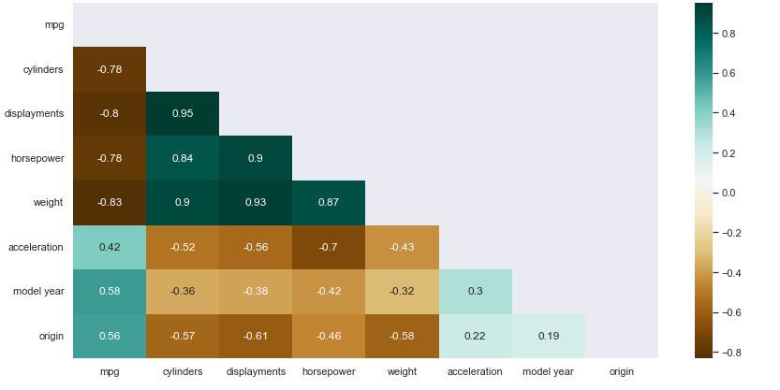
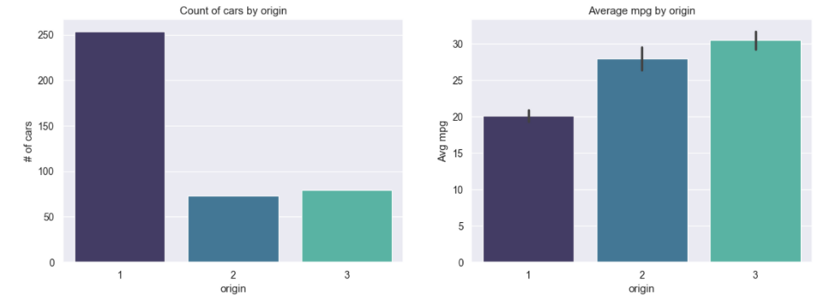
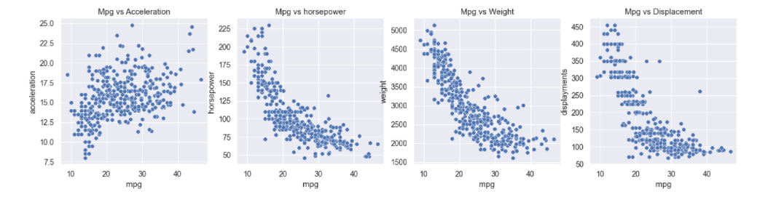
Explanatory Data Analysis & Data Preprocessing
Data Preprocessing Challenges
Figure out what to do with NA values
Correct any misspellings
Handling values with ‘extreme’ values outliers
Handling variables that highly affect one another –
high correlation
Handling variables that need encoding in order to be ‘understood’ by the computer
What data to include & what data to exclude in our model
Logarithmic scaling of target attribute
Key Change
Y = Log(1+Y)

Slide 5
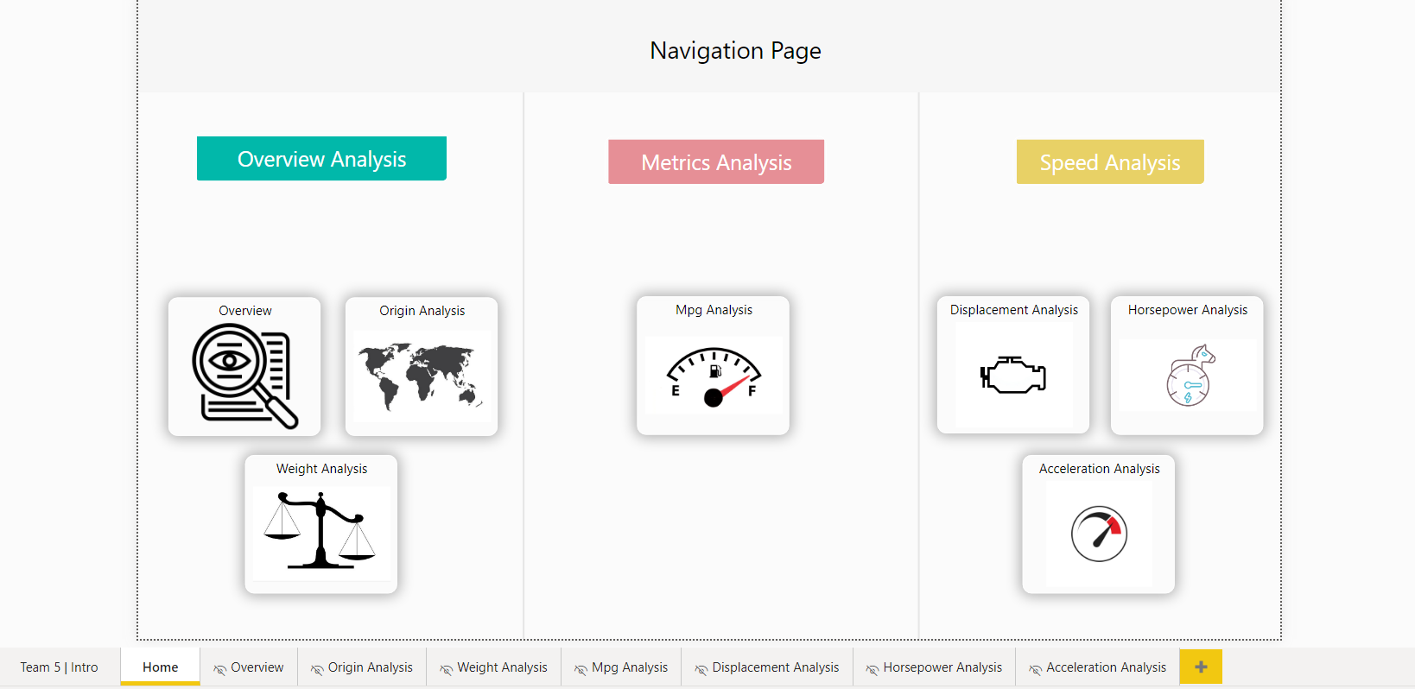
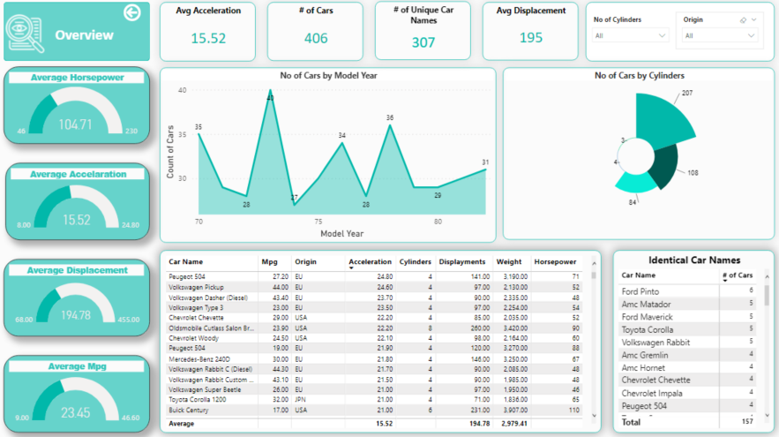
Data Visualization Power BI
‘Navigation’ page that guides the viewer and helps not to get blown away by the information that the report provides.
‘Overview’ page that helps the viewer get an idea of our data.

Slide 6
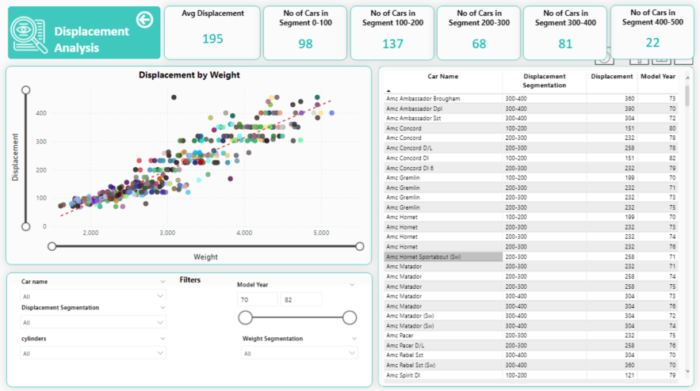
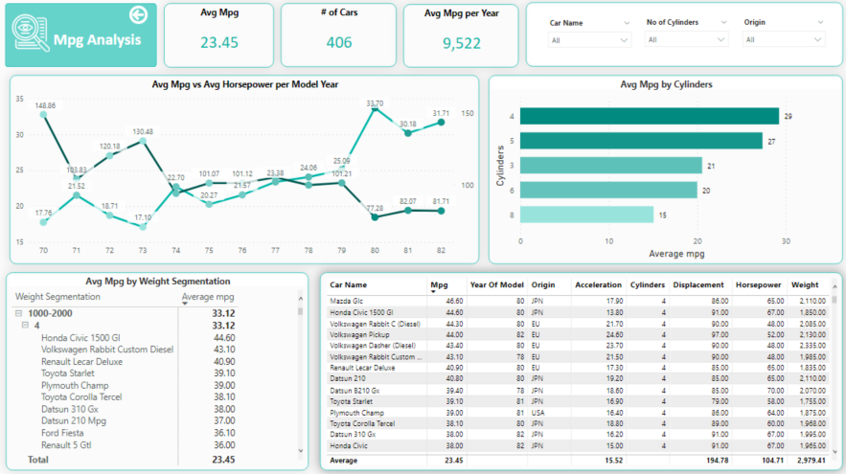
Power BI pages that:
Includes visuals that provides information without being ‘too’ complicated.
Includes many slicers in order to be easy for the viewer to be more specific with the insight that they are interested in.
Can be useful to people who are interested in different aspects.

Slide 7
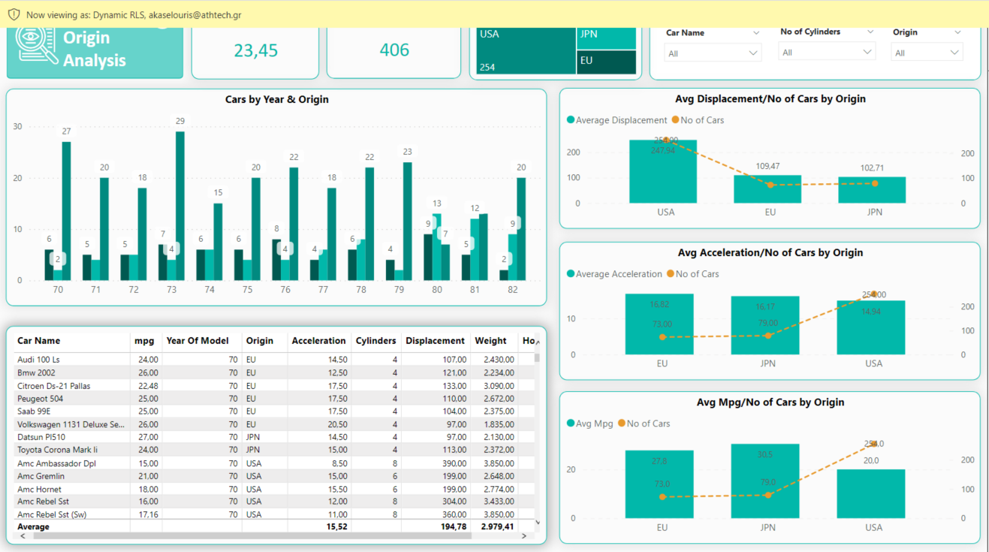
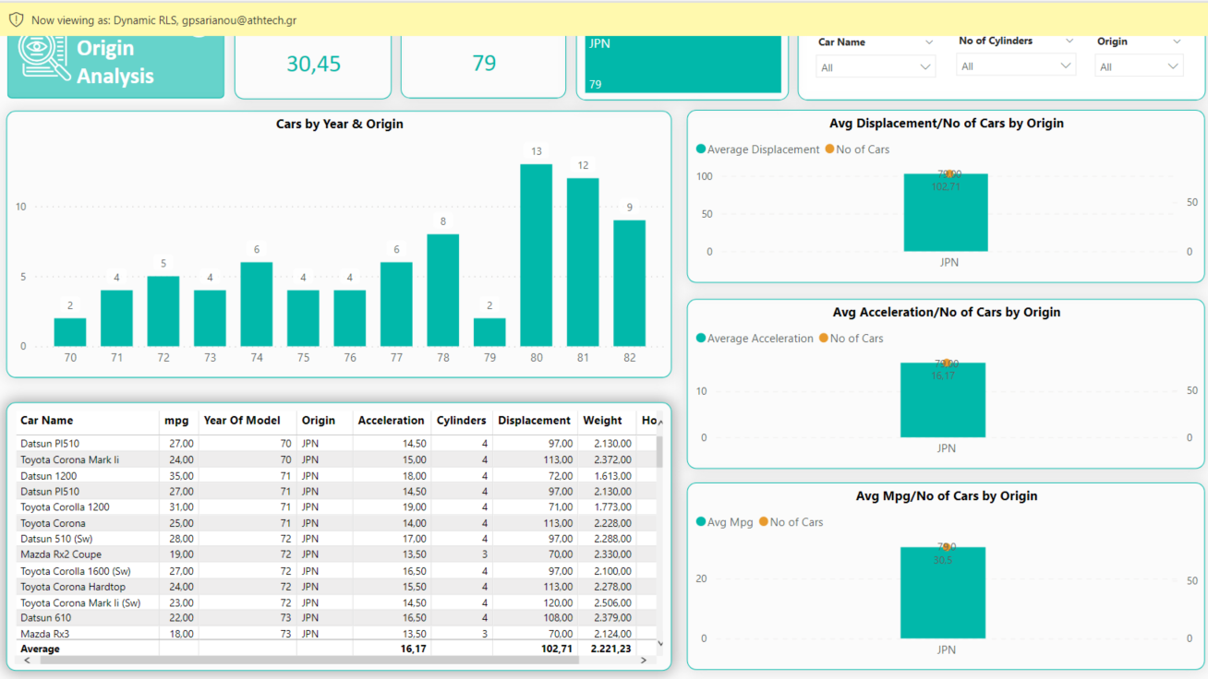
Restrict data access with Dynamic RLS Power BI
RLS: View as a Manager
RLS: View as a simple User from JPN

Slide 8
Modeling & Model Selection
Lasso Regression
Mean MSE:
0.1013
STD:
0.02224
Decision Tree Regression
STD:
0.00756
Mean MSE:
0.02022
K-Nearest Neighbor Regression
Mean MSE:
0.01632
STD:
0.00658
Linear Regression
Mean MSE:
0.01489
STD:
0.00366
Random Forest Regression
Mean MSE:
0.01217
STD:
0.00277
Gradient Boost Regression
Mean MSE:
0.01198
STD:
0.00233
Support Vector Machine Regression
Mean MSE:
0.01179
STD:
0.00235
Stacking Regression
Mean MSE:
0.01156
STD:
0.00253
Data
Linear
Prediction 1
Random Forest
Prediction 2
Prediction 3
Linear
Final Prediction
Gradient Boost
Prediction 4
Support Vector

Slide 9
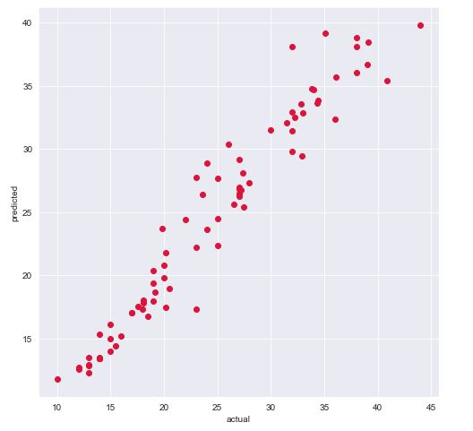
Evaluation of our Model
Our Model Evaluation:
Mean Squared Error (MSE) : 0.0059 Optimum value 0
R – Squared: 0.95 Optimum value 1
Predicted Values
Actual Value
Reconsider our Model Evaluation using Cross Validation:
Mean MSE: 0.01156 Optimum value 0
Standard Deviation: 0.00253 Poorest possible MSE : 0.01409
Optimum possible MSE : 0.00903

Slide 10



Slide 11


Thank you!

